Slide 1
Logical
RSLogix 5000
© 2015 John Sefcovic

Slide 2
LOGICAL
The Logical instruction perform the AND, OR, XOR, and NOT logic functions bit-by-bit on the entire words specified in the instructions.
In the Source A 32 bit word, the logical ‘0’ or ‘1’ at the bit position is logically operated on with corresponding bit position of the Source B 32 bit word.
The logical result is stored in the corresponding bit of the Destination word.

Slide 3
LOGICAL
For each corresponding bit position in the Source A and Source B words, there are four possible combinations of ‘0’ and ‘1’ states.
These different combinations are expressed in a TRUTH TABLE to determine the result for each possibility. The result depends on the Logical Function.
In this example, the possibilities at the same bit position in the two Source words.
TRUTH TABLE
Source A | Source B | Dest (Result)
0 | 0 | 0
0 | 1 | 0
1 | 0 | 0
1 | 1 | 1
First possible combination and result.
Second possible combination and result.
Third possible combination and result.
Fourth possible combination and result.

Slide 4
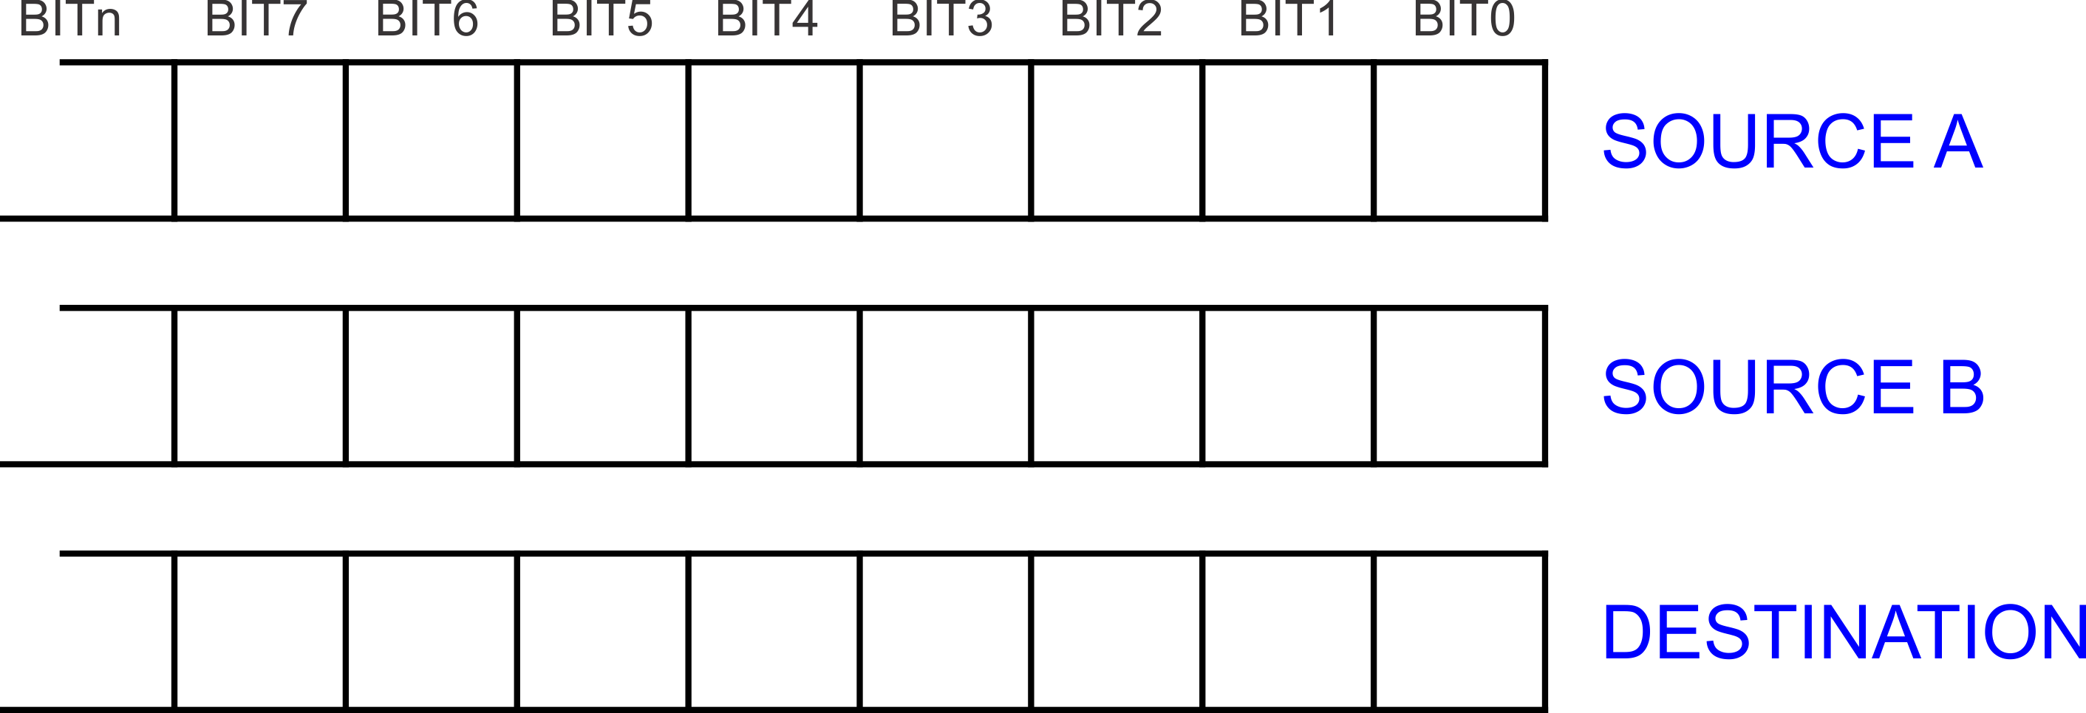
LOGICAL
The logical function would be performed on each bit of the entire Source words to determine a result in the Destination based on which combination was at the bit position.

Slide 5
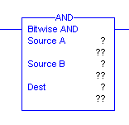
LOGICAL
AND
Source A | Source B | Dest (Result)
0 | 0 | 0
0 | 1 | 0
1 | 0 | 0
1 | 1 | 1
When rung conditions are true, the AND output instruction Source A and Source B are ANDed bit by bit and stored in the Destination. Sources A and B can be either word tags or constants; however, both sources cannot be a constant. The Destination must be an tag.

Slide 6
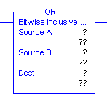
LOGICAL
OR
Source A | Source B | Dest (Result)
0 | 0 | 0
0 | 1 | 1
1 | 0 | 1
1 | 1 | 1
When rung conditions are true, the OR output instruction Source A and Source B are ORed bit by bit and stored in the Destination. Sources A and B can be either word tags or constants; however, both sources cannot be a constant. The Destination must be an tag.

Slide 7
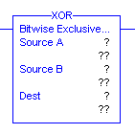
LOGICAL
XOR
Source A | Source B | Dest (Result)
0 | 0 | 0
0 | 1 | 1
1 | 0 | 1
1 | 1 | 0
When rung conditions are true, the XOR output instruction Source A and Source B are Exclusively ORed bit by bit and stored in the Destination. Sources A and B can be either word tags or constants; however, both sources cannot be a constant. The Destination must be an tag.

Slide 8
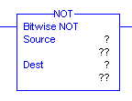
LOGICAL
NOT
Source | Dest (Result)
0 | 1
1 | 0
When rung conditions are true, the NOT output instruction Source is NOTed bit by bit and stored in the Destination. The source and destination must be word tags.

Slide 9

LOGICAL
CLEAR
When rung conditions are true, the CLR output instruction sets all the bits in the word to zero stored at the Destination. The Destination must be an tag.

Slide 10

LOGICAL
The Logical instruction buttons are in the Move/Logical Tab.

Slide 11
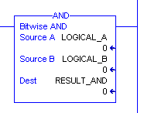
LOGICAL
TAGS and DATA
When the instruction is first entered, there are three sets of question marks⁽¹⁾.
Three of the question marks are for the tags.
When the rung is verified, the current value at the tags is shown.
⁽¹⁾ The NOT instruction has a Source and Destination. CLR has only a Destination.

